Slide 1
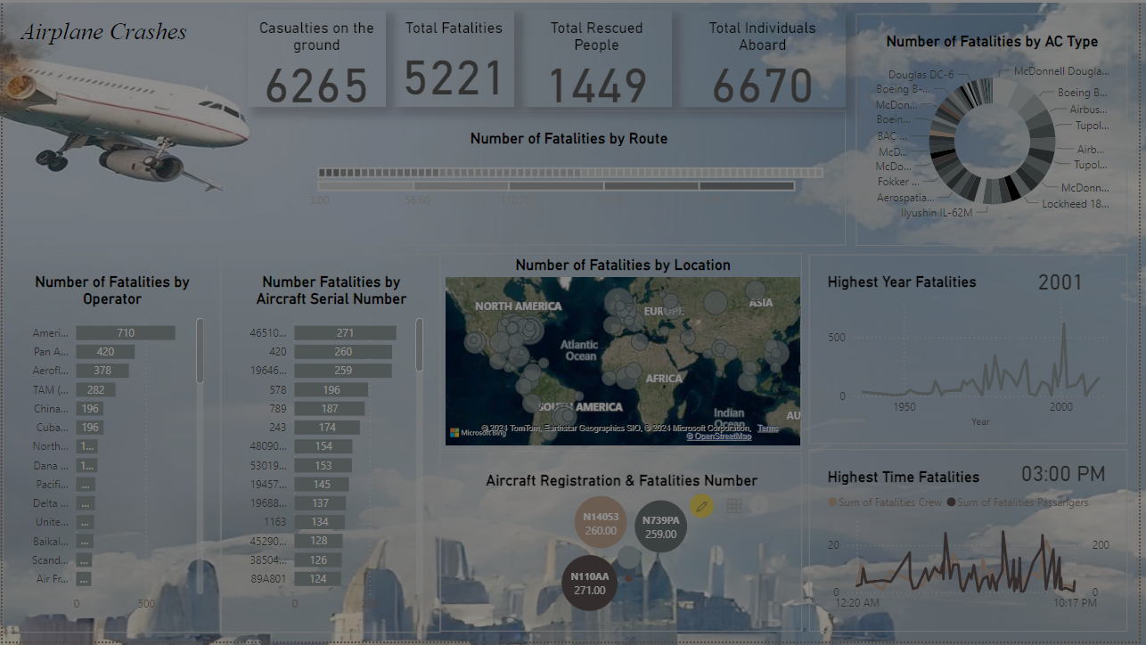
Airplane Crashes Analysis with PowerBI
Internship Project by Moamena Samir with Mentorness
Batch – MIP-DA-06

Slide 2

Content
About the Project
Dataset Description
Import the Data
Clean the Data
Visualize the Data
Final Dashboard
Analysis conclusions
What I Learn

Slide 3
About the Project
This project analyzes airplane crashes (1980-2023) using Power BI for interactive visualizations.
Dataset includes crash details, fatalities.
Objectives: temporal/geospatial analysis, operator/aircraft performance, fatality trends, route analysis.
Deliverables: Power BI dashboards, reports. Aims to enhance aviation safety.

Slide 4
Dataset Description
Date: Date of the airplane crash.
Time: Time of the airplane crash.
Location: Location where the airplane crash occurred.
Operator: Operator or airline involved in the incident.
Flight #: Flight number associated with the incident.
Route: Planned route of the flight.
AC Type: Aircraft type involved in the crash.
Registration: Registration details of the aircraft.
cn/ln: Construction or serial number of the aircraft.
Aboard: Total number of individuals aboard the aircraft.
Aboard Passengers: Number of passengers aboard the aircraft.
Aboard Crew: Number of crew members aboard the aircraft.
Fatalities: Total fatalities in the incident.
Fatalities Passengers: Number of passenger fatalities.
Fatalities Crew: Number of crew member fatalities.
Ground: Casualties on the ground, if any.
Summary: Summary or description of the incident.

Slide 5
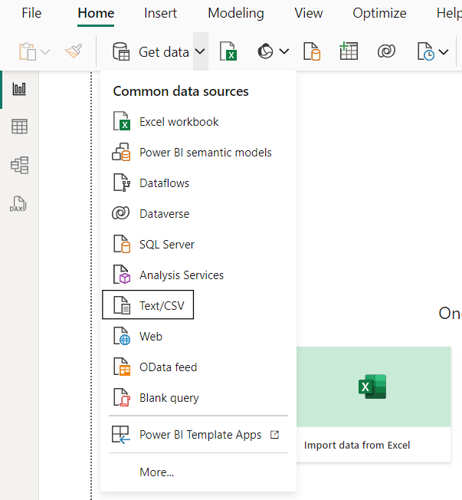
Import the Data
Import Data as CSV File:

Slide 6
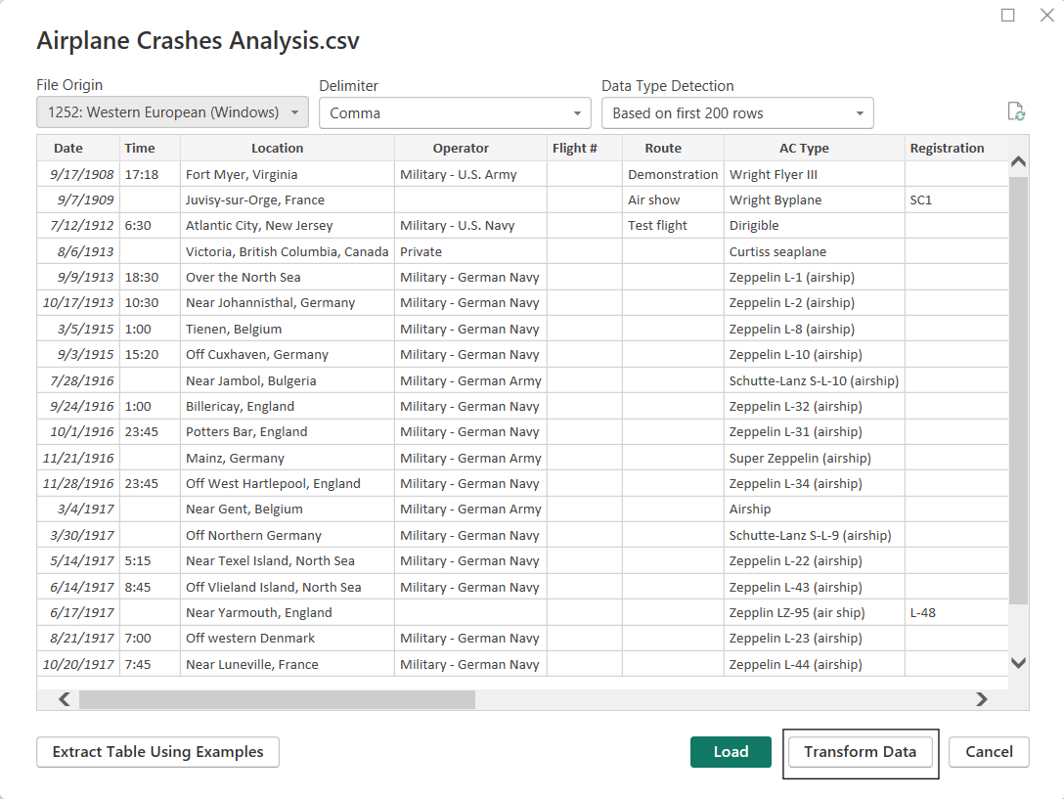
Clean the Data
Transform Data:

Slide 7
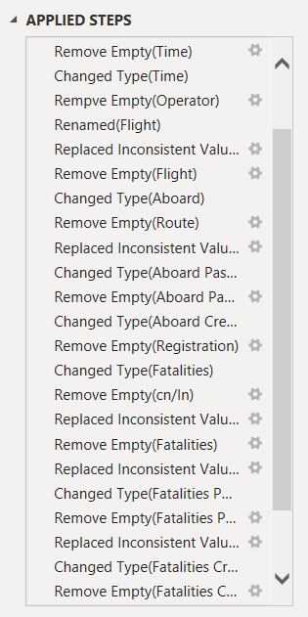


Clean the Data
Remove Empty Value.
Change Data Type.
Replace Inconsistent Value.
Rename Some Column.
Apply Change to visualize

Slide 8
Visualize the Data
Objectives:
Temporal Analysis
Geospatial Analysis
Operator Performance
Aircraft Analysis
Fatality Trends
Route Analysis

Slide 9
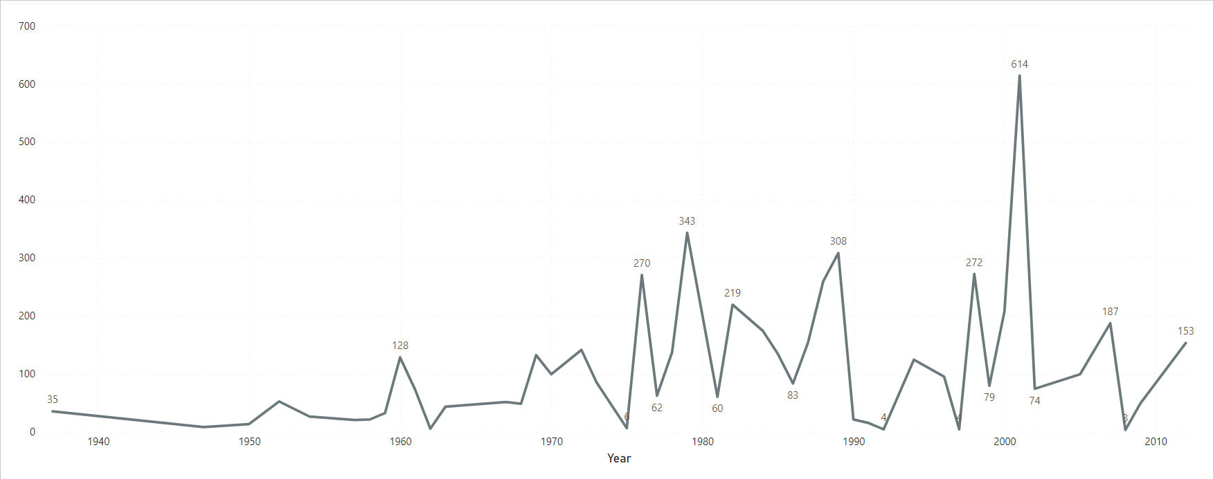
1. Temporal Analysis
What I Use?
A line chart
Why?
To explore temporal trends by showing the number of airplane crashes per year.
Analysis conclusion:
Through this visualization, you can discover that the year 2001 was the highest airplane fatalities rate in the world with 614 individuals

Slide 10
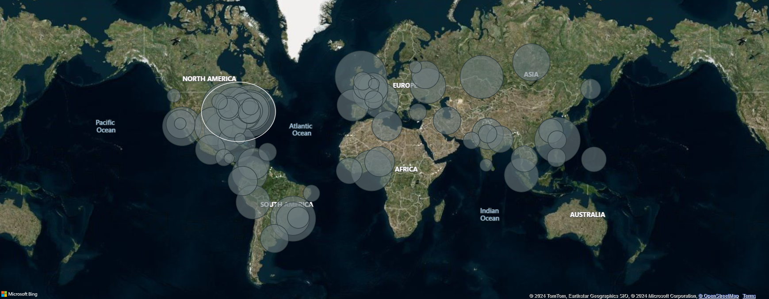
2. Geospatial Analysis
What I Use?
A map
Why?
Showing the locations of crash incidents to identification of hotspots where a higher frequency of crashes occur by total fatalities.
Analysis conclusion:
Through this visualization, you can discover that Chicago O'Hare, Illinois was the highest airplane fatalities rate in the world with 271 individuals

Slide 11
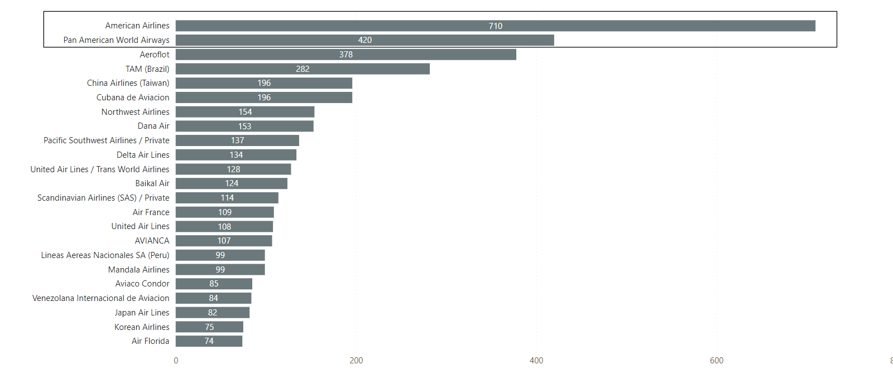
3. Operator Performance
What I Use?
A bar chart
Why?
To showcasing the number of crashes for each operator with the length of the bar representing the frequency of crashes.
Analysis conclusion:
From this visualization, you can discover that the American Airlines operator had the highest aircraft fatality rate in the world at 710, followed by Pan American World Airways with 420 individuals.

Slide 12
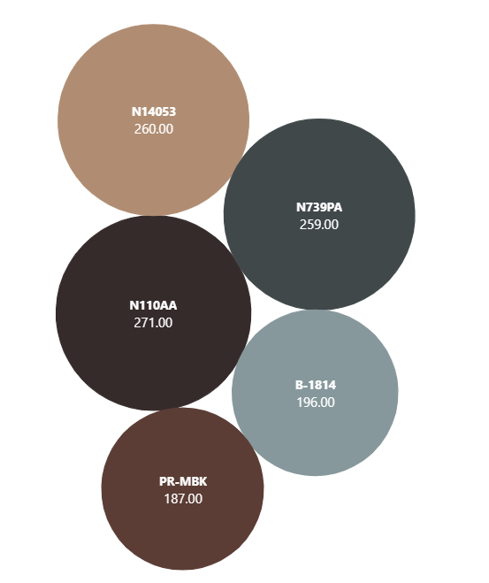
4. Aircraft Analysis (1)
What I Use?
A bubble chart
Why?
To show correlations between aircraft registration and the number of fatalities
Analysis conclusion:
Through this visualization, you can discover that there is a relationship between the Registration details of the aircraft (N110AA) and the number of fatalities, as it represents the cause of 271 of fatalities.

Slide 13
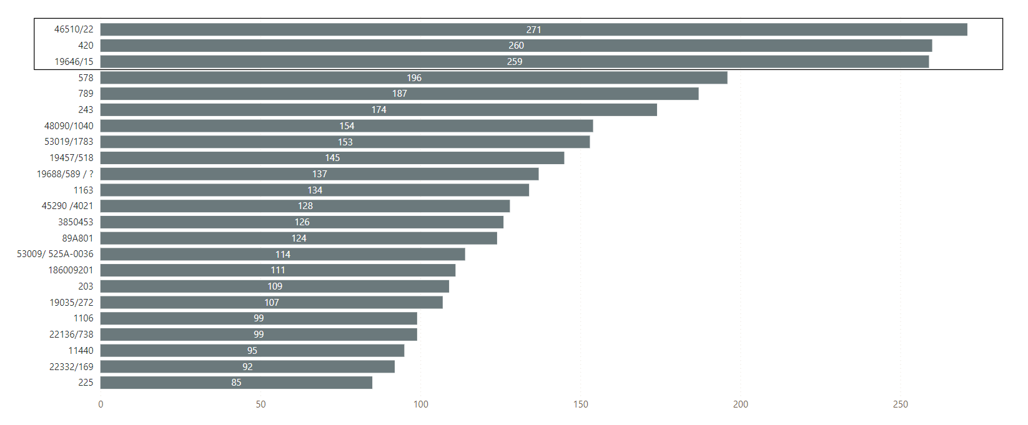
4. Aircraft Analysis (2)
What I Use?
A bar chart
Why?
To show the frequency of incidents for each aircraft type by number of fatalities.
Analysis conclusion:
From this visualization, you can discover that the Airplane with serial number(46510/22) had the highest aircraft fatality rate in the world at 271, followed by Airplane with serial number(19646/15) with 259 individuals.

Slide 14
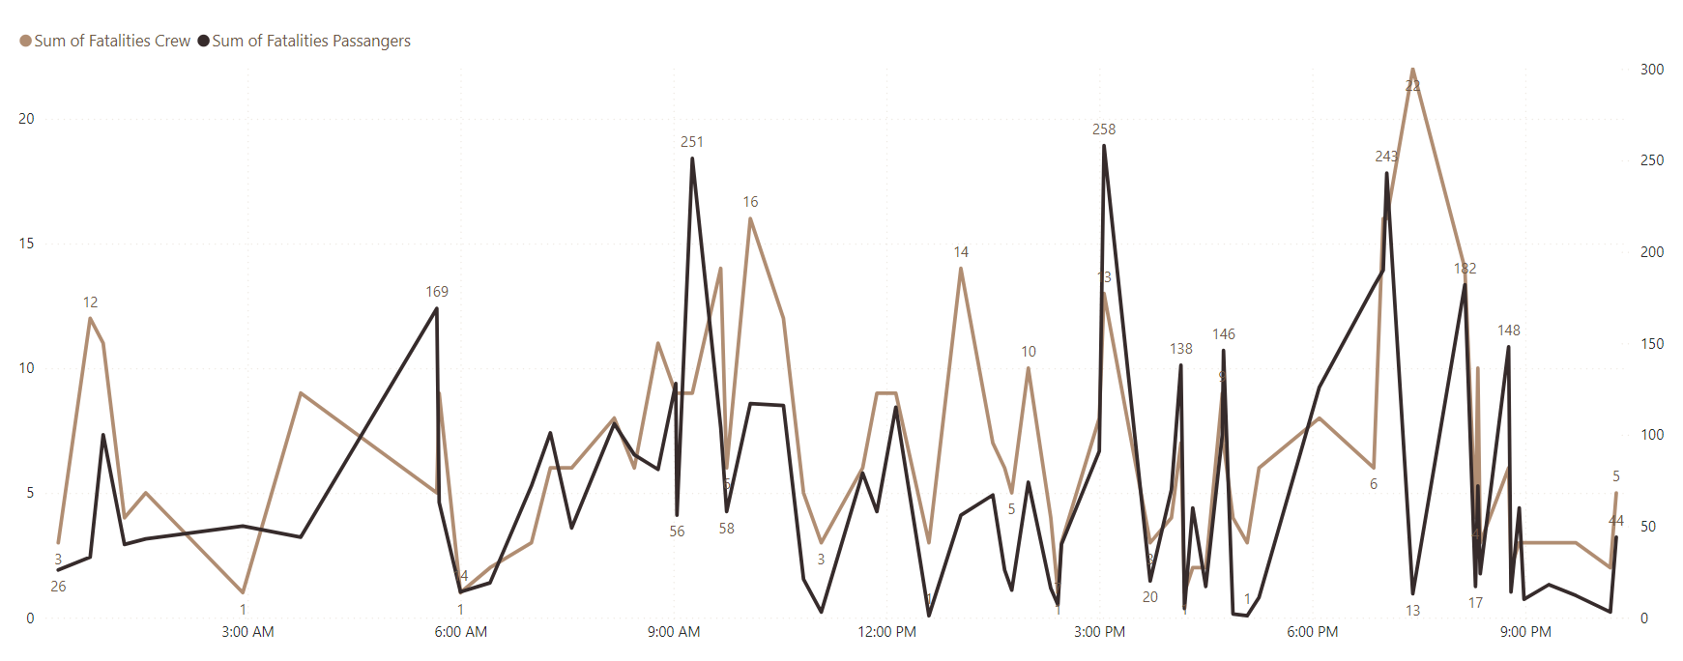
5. Fatality Trends (1)
What I Use?
A line chart
Why?
To explore number of fatalities in passenger and crew over time.
Analysis conclusion:
Through this visualization, you can discover that the time 9 AM : 8 PM was the highest airplane fatalities rate in the world.

Slide 15
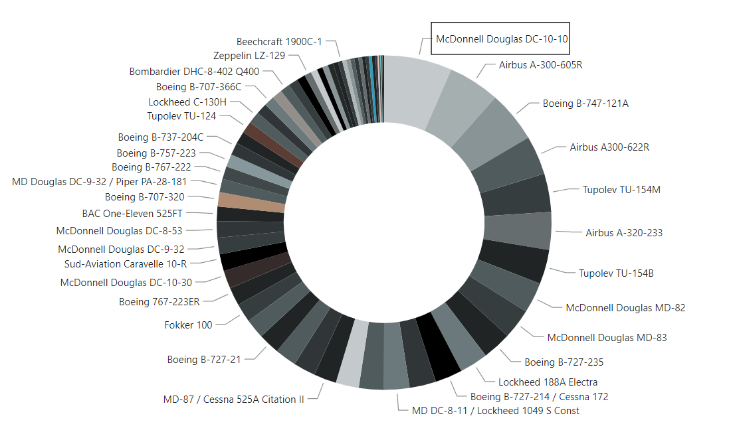
5. Fatality Trends (2)
What I Use?
A daunt chart
Why?
To show correlations between different AC Type and the number of fatalities.
Analysis conclusion:
Through this visualization, you can discover that there is a relationship between the AC Type: McDonnell Douglas DC-10-10 and the number of fatalities, as it represents the cause of 7% of fatalities.

Slide 16
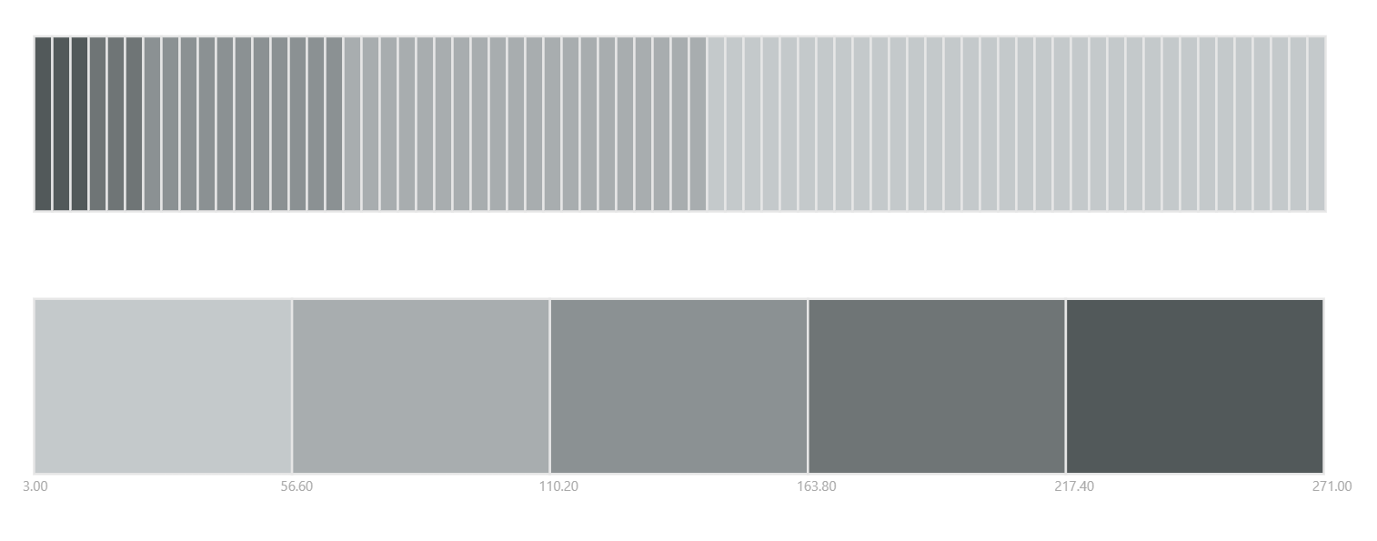
6. Route Analysis
What I Use?
A heatmap
Why?
To identify routes that have a higher likelihood of incidents.
Analysis conclusion:
Through this visualization, you can discover that Route: Chicago, IL- Los Angeles, CA was the highest airplane fatalities rate in the world with 271 individuals.

Slide 17
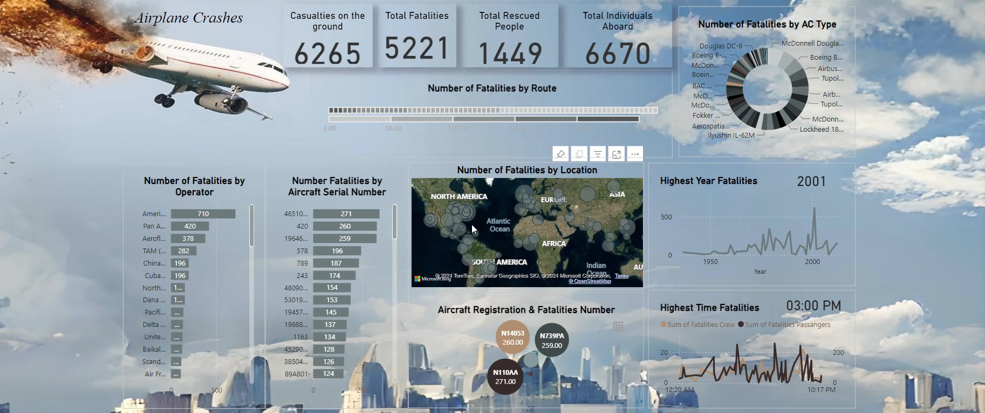

Slide 18
Analysis Conclusions
Chicago O'Hare, Illinois, especially along route (Chicago, IL- Los Angeles, CA), has the highest airplane fatality rate in the world.
The year 2001 was the highest airplane fatalities rate in the world.
There is a relationship between the Registration details of the aircraft (N110AA), AC Type: McDonnell Douglas DC-10-10 and the number of fatalities.
There is a relationship between operator: American Airlines with serial number(46510/22) and the number of fatalities.

Slide 19
What I Learn
How and when to use different type of visualizations.
How uncleaning data can make your visualization unreadable.
Source File:Power BI

Slide 20
Thank You

